Slide 1
Predicting the pricing of Airbnb venues

Slide 2
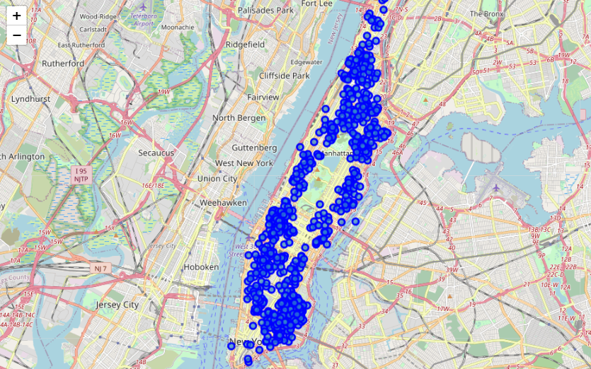
Introduction
AirBnBs in New York
Valuable to know the
pricings for the
upcoming year
Can we predict the prices?
Add data from other sources
Compare the original dataset with a supplemented dataset

Slide 3
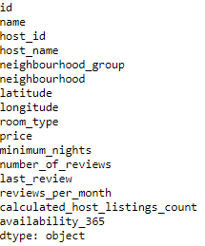
Data description
Data sources
Kaggle → Airbnb dataset
Foursquare → nearby venues
Data processing
Data cleaning
Data transformation

Slide 4
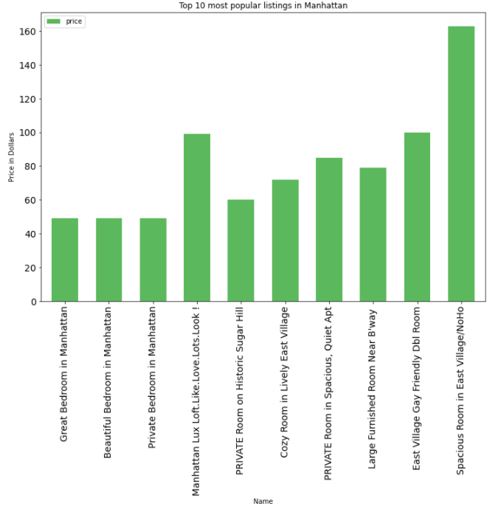
Methodology
Foursquare API
Venues in radius of 500 meters
Models
Linear regression
2 models for each dataset
Decision tree
Outcome measure
R²

Slide 5
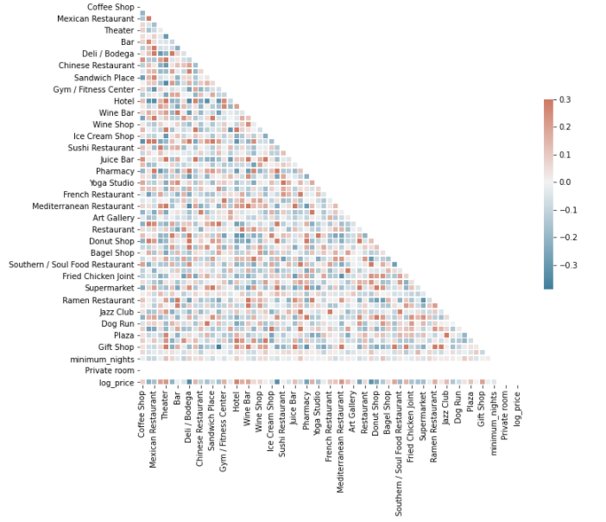
Result
Decision tree performed best
Supplemented dataset performs
better
Little to no multicollinearity
 | OLS (supplemented) | Decision Tree | OLS (original)
R² | 0.178 | 0.233 | 0.010

Slide 6
Discussion & Conclusion
Foursquare does add to the prediction
Models still perform poorly
Foursquare does add to the prediction
Models should be redone using backwards selecton and the entire dataset
Limited amount of API-calls main limitation

Slide 7
Questions?
Thank you for your time!

